Slide 1

Final Project
Advances in Data Sciences Product Review Sentiment Analysis
Group - 3
Archana Chintha
Bhanuja Nagore
Nithin Kartha
XingShu Cui
Mar 15th, 2017
Professor: Dr. Subrata Das

Slide 2

Table of Contents:
Problem Statement
Approach & Method Used
Data Scraping & Storing
Stemming & Sentiment Analysis
DBN
SVM
CNN
Data Story

Slide 3

Problem Statement & Approach
Data Scraping and Storing –(Using Rvest and CSS selectors)
Stemming lexicon and reviews.
Sentiment Analysis using positive/negative lexicon.
Model Building – (DBN, CNN and SVM)
Sentiment Analysis is the process of computing, identifying or categorizing opinions expressed in a piece of text, in order to determine weather the attitude expressed in it is positive, negative, or neutral.

Slide 4
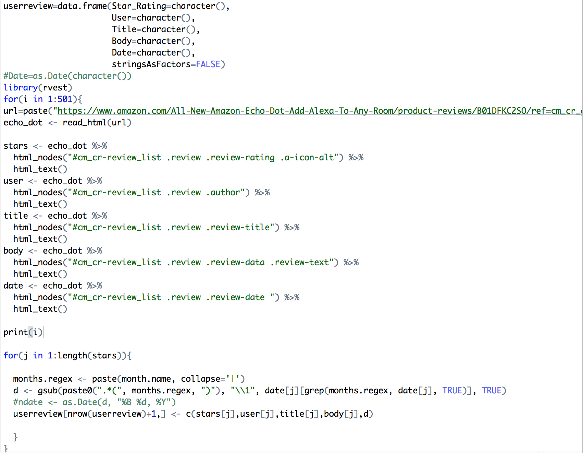
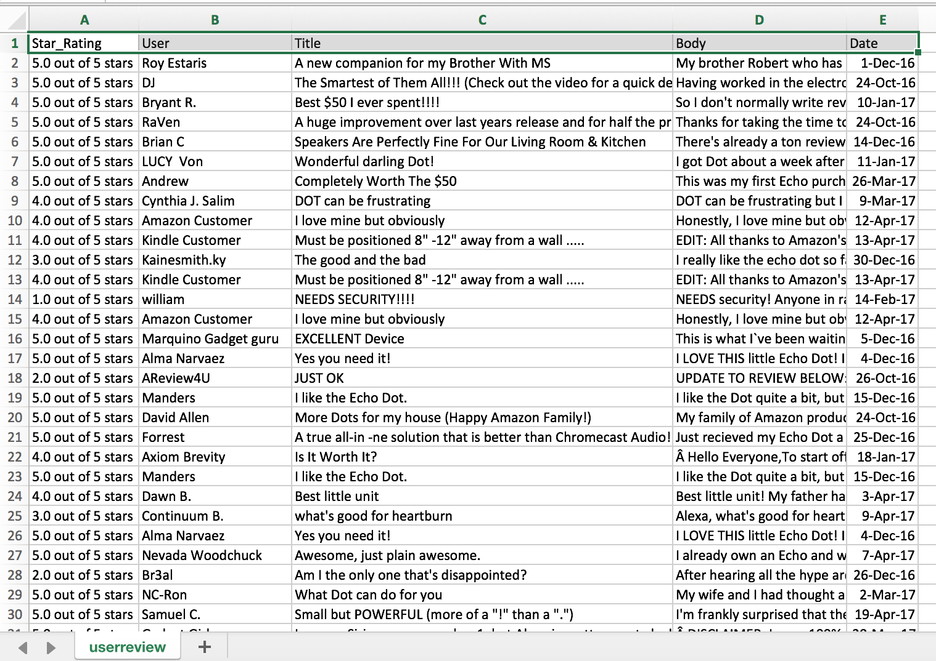
Data Scraping
Web scraping is data scraping used for extracting data from websites. With web scraping we can access the World Wide Web directly using the HTTP or through a browser.
Steps involved during Web scraping were:
Looped Amazon Echo dot product review page URL for 500 pages.
Using Rvest and CSS selectors scrubbed 5000 review along with UserrId and Star Ratings.
Notes:
Lesson descriptions should be brief.

Slide 5
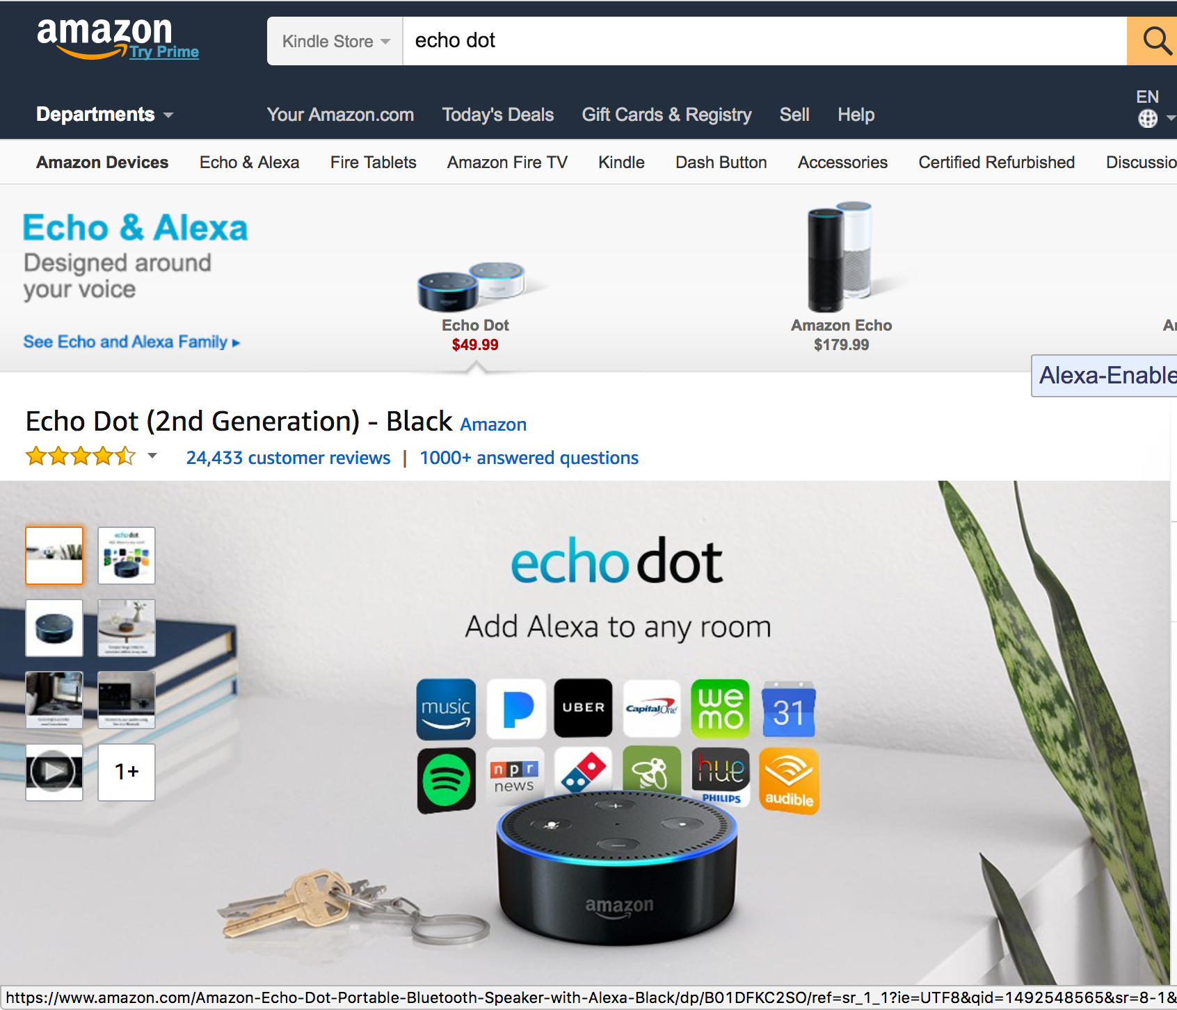
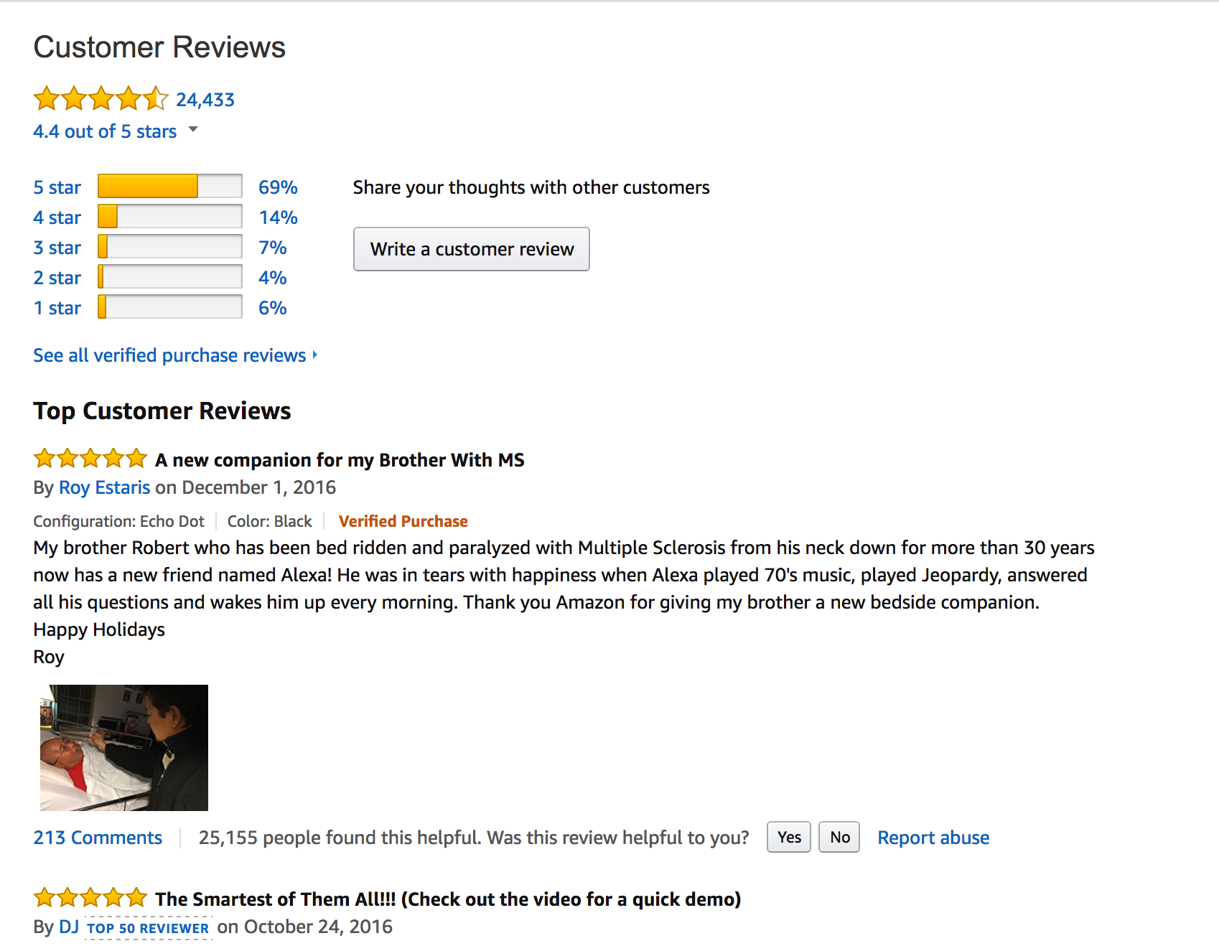
Data Scraping
Amazon Echo dot is a hands-free, voice-controlled device that uses Alexa to play music, control smart home devices, provide information, read the news, set alarms, and more..
It has more than 24,000 product reviews in amazon.

Slide 6
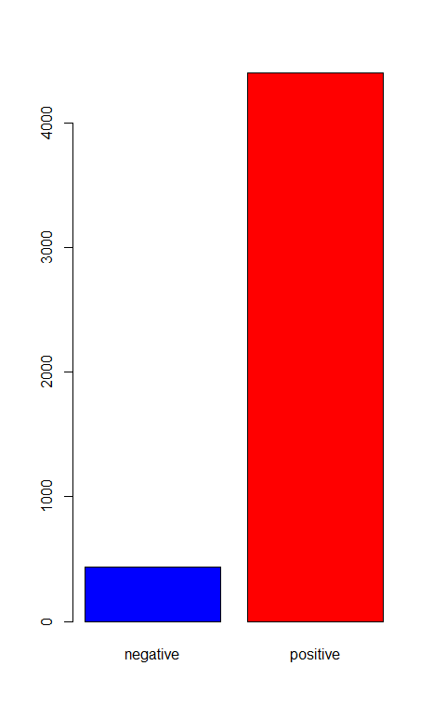
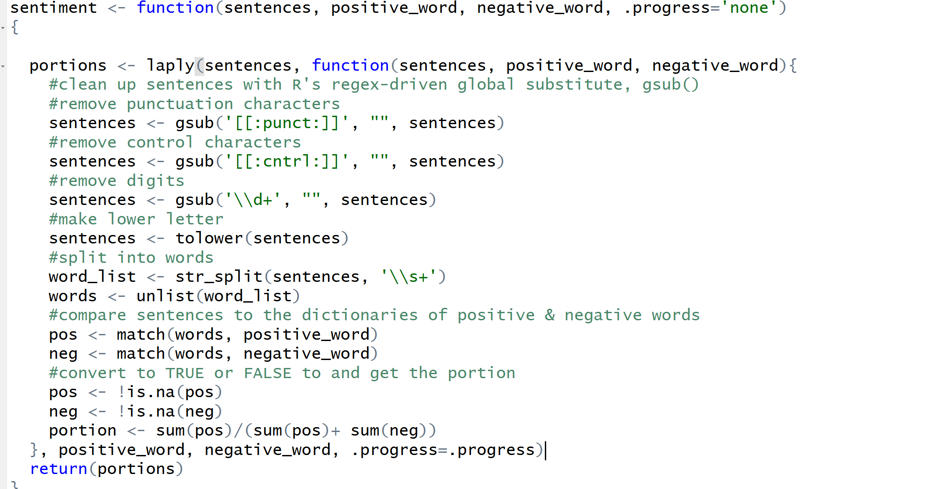
Sentiment Analysis
Sentiment analysis is classifying the polarity of a given text at the document, sentence, or feature/aspect level—whether the expressed opinion in a document, a sentence or an entity feature/aspect is positive, negative, or neutral.
Steps involved during Sentiment Analysis were:
Use Regular expression to remove punctuation and control characters
Split each reviews and make it lower letter
Download positive/negative documents, and compare each word with the documents to get whether it’s positive and negative

Slide 7
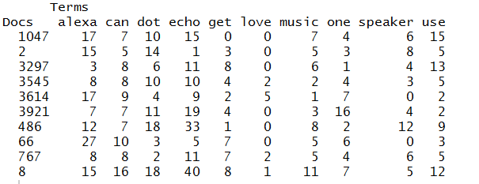
Sparse Representation
Sparse representation (SR) is used to represent data with as few atoms as possible in a given over complete dictionary
Steps involved during Sparse Representation were:
Converting the amazon reviews to a corpus
Performing the stemming process to the corpus using tm_map
Converting the stemmed corpus to a Document-Term-Matrix (DTM)
Notes:
Lesson descriptions should be brief.

Slide 8
DBN: Introduction & Steps
DBN (deep belief network) is a generative graphical model, or alternatively a type of deep neural network, composed of multiple layers of latent variables, with connections between the layers.
Steps involved during building the DBN:
Take 90% of data to be train data, and 10% of data to be test data.
Label the sentiment data, positive as 1, negative as 0.
Train the neural network where the weights are initialized by a deep belief network via dbn.dnn.train().
Set the number of layer as 10.
Use the trained network to predict results via nn.predict().
Transform the prediction into an error rate via nn.test().

Slide 9
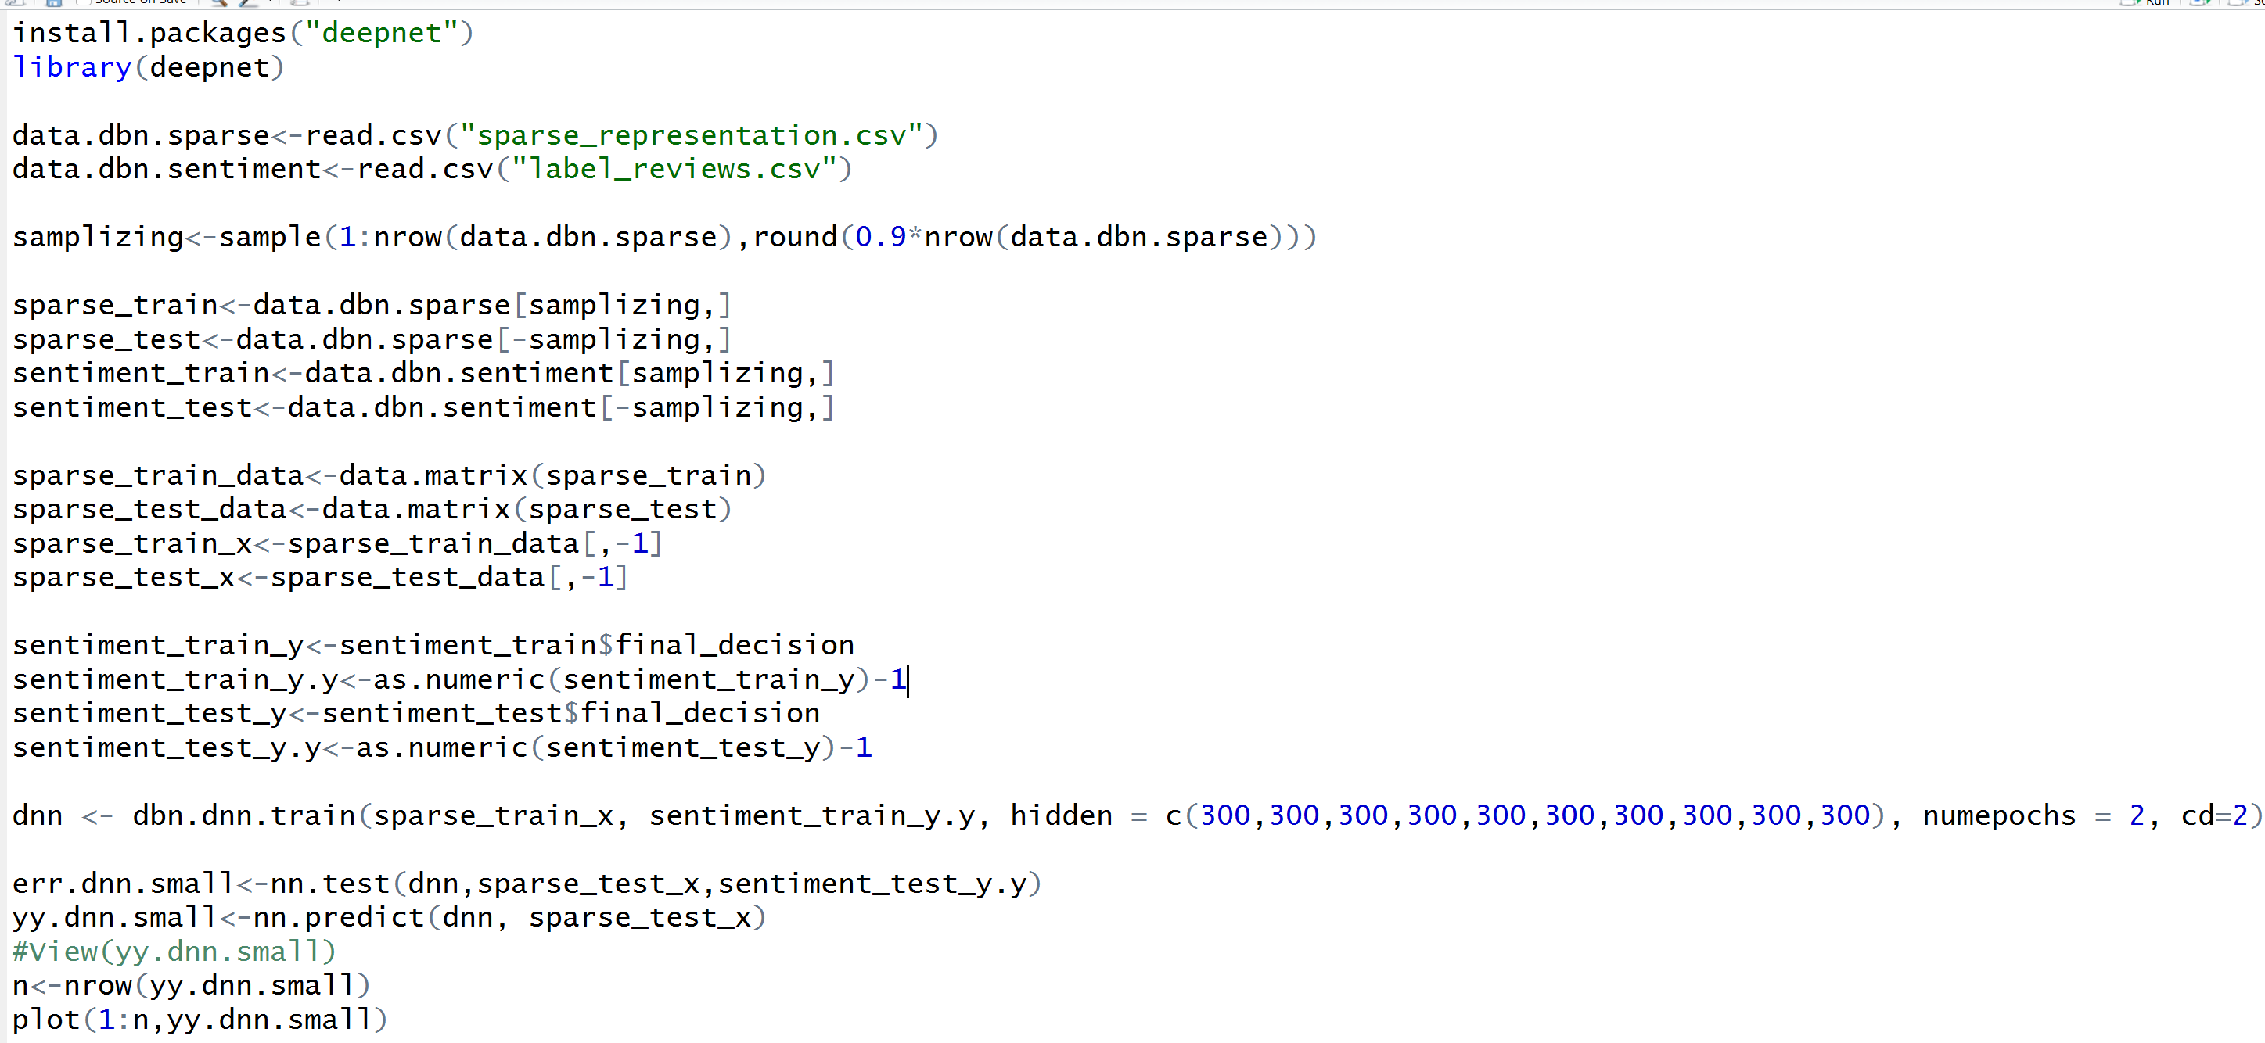
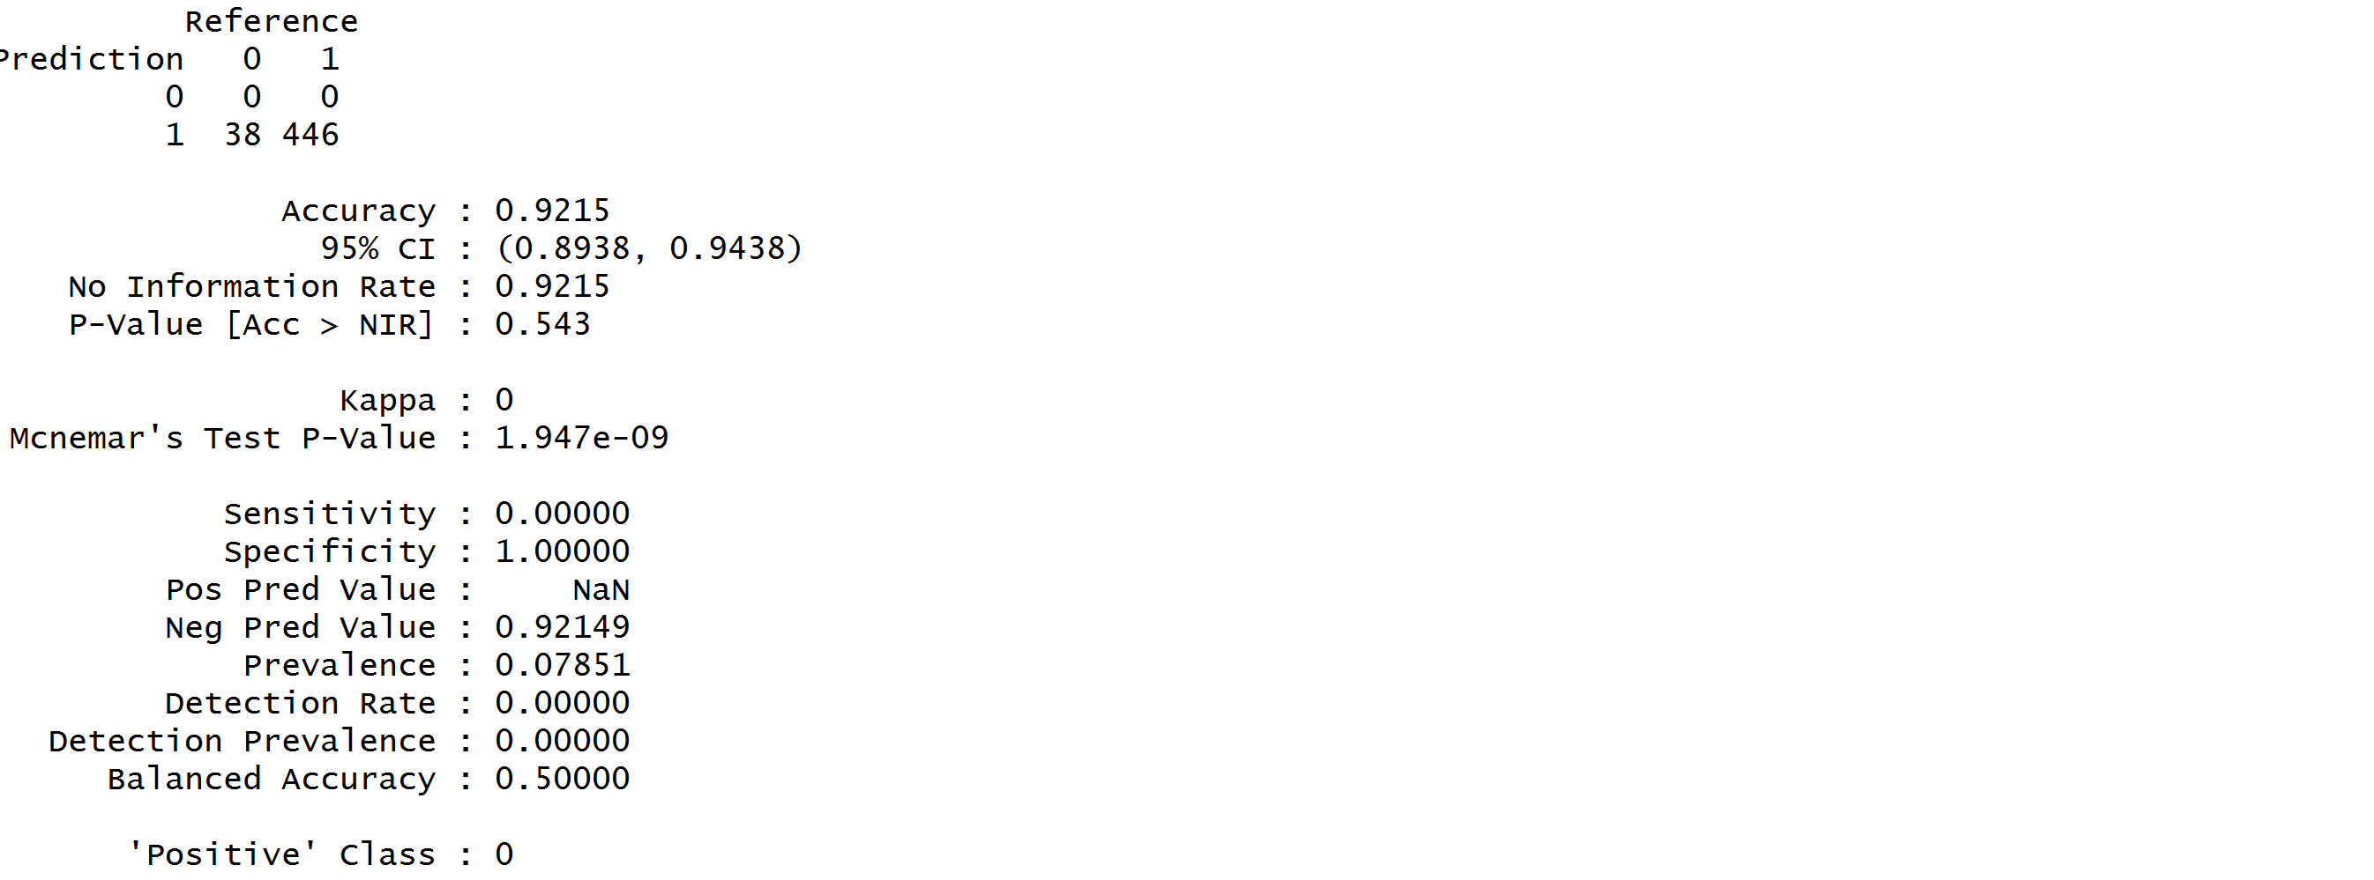
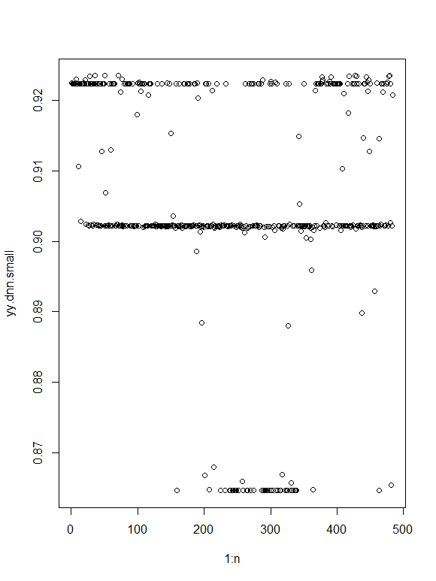
DBN: Introduction & Steps
The accuracy is 92% and error rate is 0.0392

Slide 10
SVM Regression: Introduction & Steps
The support vector machine is a training algorithm for learning classification and regression rules from data. SVMs are based on the structural risk minimization principle.
Steps involved during building the SVM regression were:
Using data frame combine the sparse representation matrix and the decision of the sentimental analysis.
Evaluate the model accuracy using the ConfusionMatrix function of caret package.
Predicting the 20% test data using the build SVM model and generated the confusion matrix.
After tuning, rebuilding the SVM model using tuned best cost and gamma value.
Tuning the built model by passing a range of cost and gamma values.
Building the SVM model using the train data and checking the predicted data accuracy using confusion matrix.
Sampling the train dataset by splitting it into 80% train data and 20% test data.
Notes:
Lesson descriptions should be brief.

Slide 11
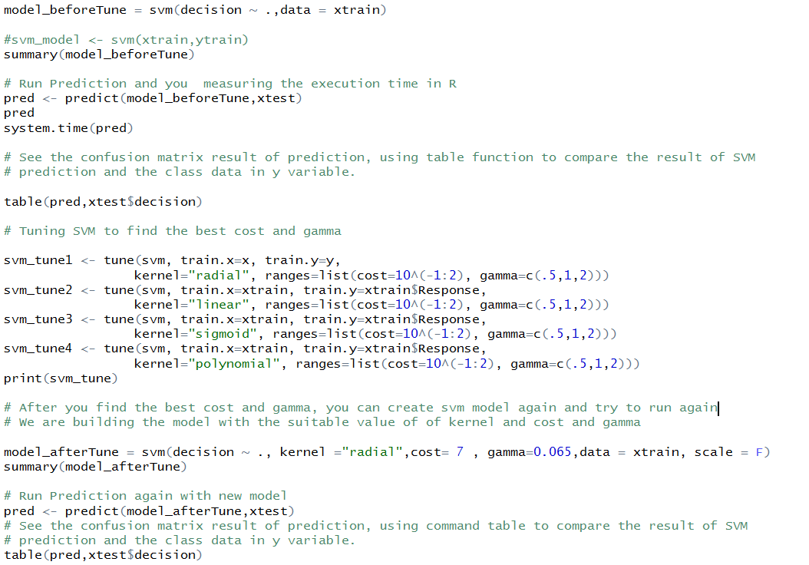
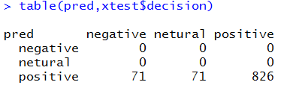
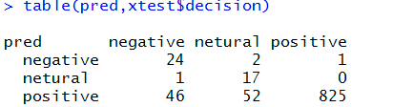
SVM Classification: Code & Summary
Code Snippet:
Before tuning Model:
After tuning Model:

Slide 12
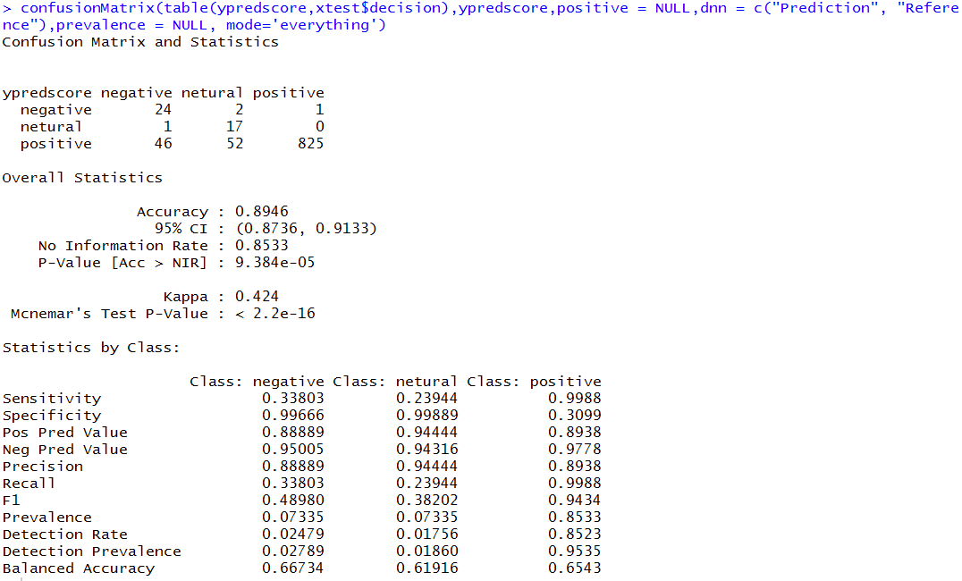
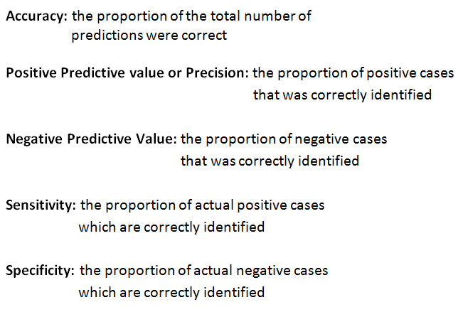
SVM Classification: Evaluation
Compute Accuracy:
Statistics:

Slide 13
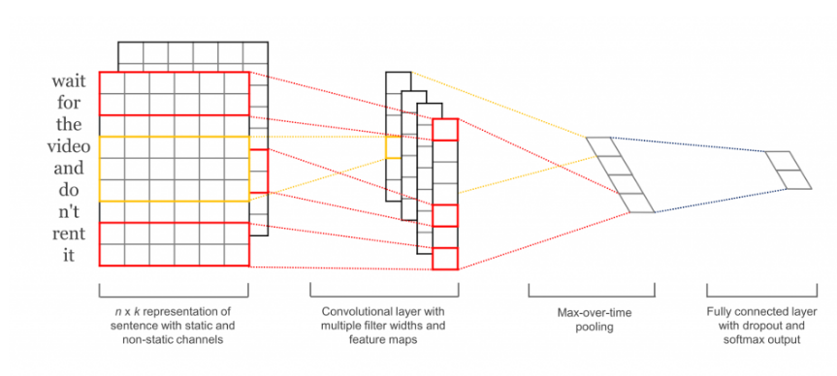
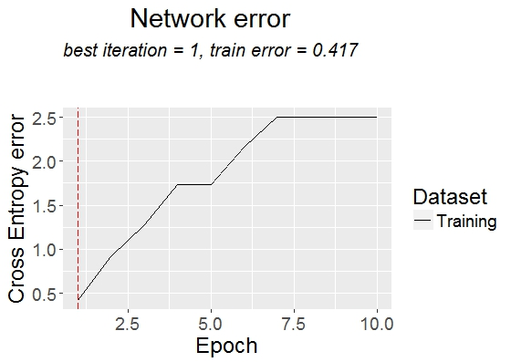
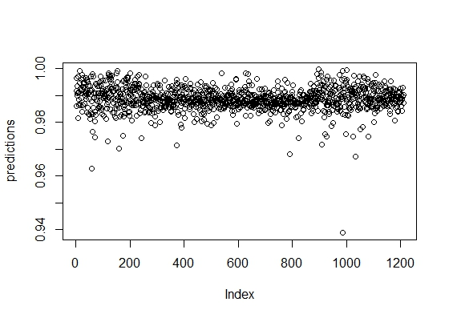
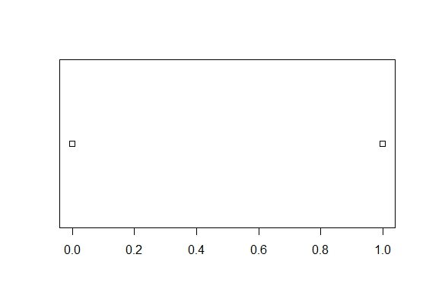
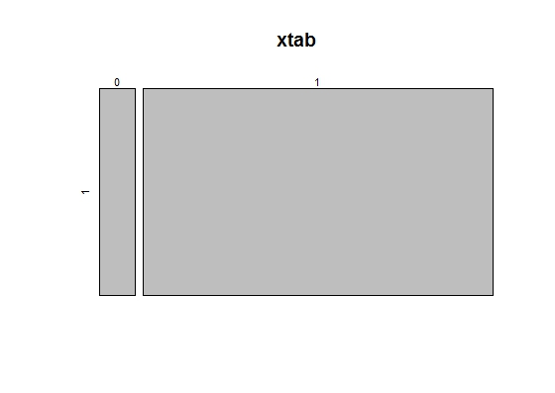
CNN: Introduction & Steps
Model achieves a good classification performance across a range of text classification tasks (like Sentiment Analysis) and has since become a standard baseline for new text classification architectures
The first layers embeds words into low-dimensional vectors
The next layer performs convolutions over the embedded word vectors using multiple filter sizes
Steps involved during building the CNN:
Train a convolutional deep network model on product review sentences from Amazon labeled with their sentiment
Sampling the train dataset by splitting it into 75% train data and 25% test data
Building the CNN model using the train data and checking the predicted data accuracy using confusion matrix
Evaluate the model accuracy using the Confusion Matrix function of caret package
The result is a model that can classify a sentence based on its sentiment (with 1 being a positive sentiment, 0 being a negative sentiment)
Fetched the labeled training data of positive and negative sentiment sentences
Processed it into sets of vectors that are then split into train and test
Executed the training and testing, which in-part mxnet automatically does
Notes:
Lesson descriptions should be brief.

Slide 14
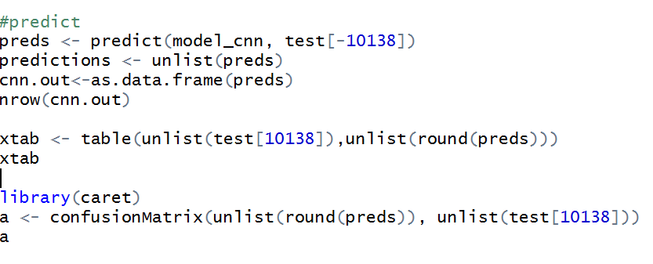
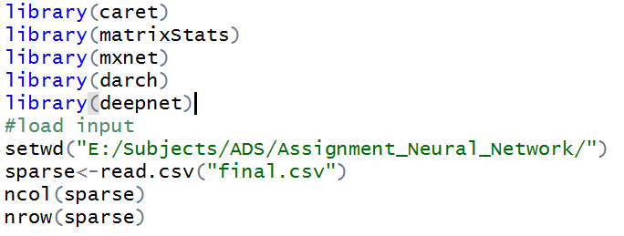
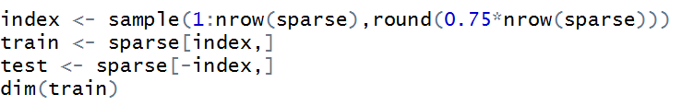
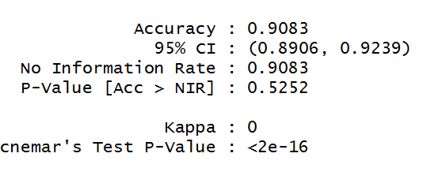
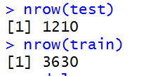
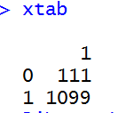
CNN – Code

Slide 15
Data Story
Data was web scraped from Amazon Echo dot product review page. More than 5000 reviews where extracted and stored in the needed format.
Sentimental analysis was done on the extracted reviews(removed stop word, punctuation, digits)
Sparse the stemmed data to get DocTermMatrix .
SVM, DBN, CNN models are used to predict the sentiment. Three different results has been obtained, based on which the error and accuracy level is computed.
Comparing the three accuracy levels, SVM resulted in 89.5% accuracy, CNN resulted in 90% accuracy and DBN has 92% accuracy and an error rate of 0.0392. Hence is the best model to predict the sentiment of amazon review is DBN.

Slide 16
Thank You!

